Slide 1

B.N.M. Institute of Technology An Autonomous Institution under VTU
Department of Information Science & Engineering
Mini Project Presentation
on
“Problem Solving for Operating System”
Presented By Under the Guidance of
Mrs. KAVYA N L Yathin G Kummar 1BG22IS065 Asst. Prof
2023-24

Slide 2
Presentation Outline
Introduction
Objectives
Methodology
Implementation
Results
References

Slide 3
Introduction
Codex, A premier coding platform designed to empower learners and enthusiasts in their programming journey. Codex stands out as a comprehensive resource hub, offering a rich collection of learning materials, including books and online compilers, to cater to a diverse audience.
Whether you are a interested to explore the fundamentals or an experienced coder looking to enhance your skills, Codex provides a curated selection of resources for Python, Java, and C across various skill levels .
With a user-friendly interface and a commitment to fostering a supportive community, Codex is the ideal destination for anyone seeking to delve into the realms of Python, Java, and C programming.

Slide 4
Objectives
At Codex, our goal is simple yet powerful: to make coding accessible and enjoyable for everyone, regardless of their skill level. We've crafted a platform that goes beyond just teaching coding—it's a place where learners can thrive and build a strong foundation in Python, Java, and C.
Comprehensive Learning Resources:
Flexibility and Convenience:
Practical Skill Development:

Slide 5
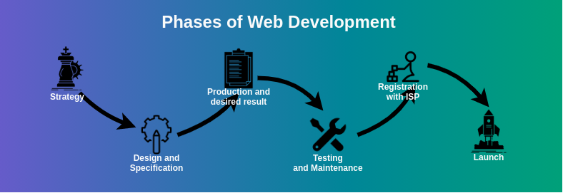
Methodology
Codex employs a multifaceted methodology designed to create an effective and engaging learning experience for users across various proficiency levels in Python, Java, and C. Our approach is characterized by the following key principles:
Structured Learning Paths:
Curriculum Design: We offer structured learning paths that guide users through foundational concepts to advanced topics.
Module Segmentation: Content is broken down into manageable modules, allowing users to grasp one concept before moving on to the next.
Diverse Learning Materials: Codex integrates a wide range of resources, including books, tutorials, and documentation.

Slide 6
Implementation
Frontend Development:
-Use modern frontend technologies (e.g., React, Visual Studio) to create an intuitive and interactive user interface.
-Implement a responsive design to enhance user experience on different devices.
Backend Development:
-Choose a backend technology stack (e.g., Node.js, Django,,XAMP) to handle server-side logic and database operations.
-Develop APIs for user authentication, content retrieval, and community features.
Database Design:
-Design a database schema to store user profiles, progress data, and content information.
-Implement database interactions to ensure efficient data retrieval and storage.
Online Compiler Integration:
-Develop or integrate an online compiler using appropriate technologies (e.g., Docker, Kubernetes).
-Ensure security measures are in place to protect user data and prevent code injection vulnerabilities
Deployment and Scaling:
-Implement scalability measures to handle growing user numbers..

Slide 7
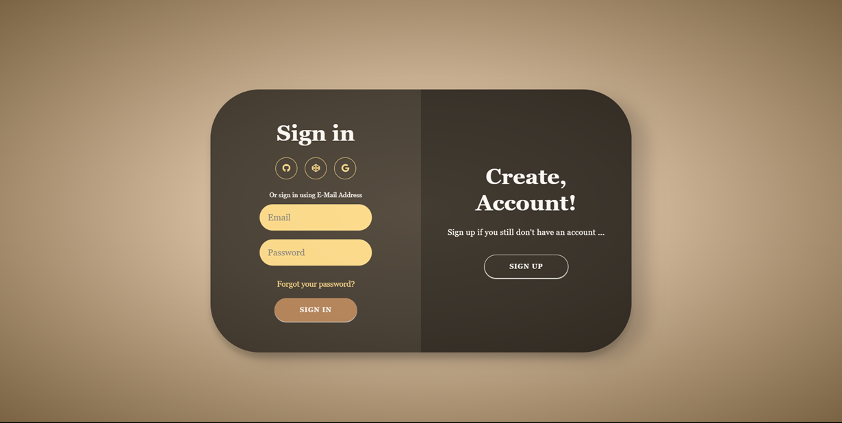
Results
Sign up page

Slide 8
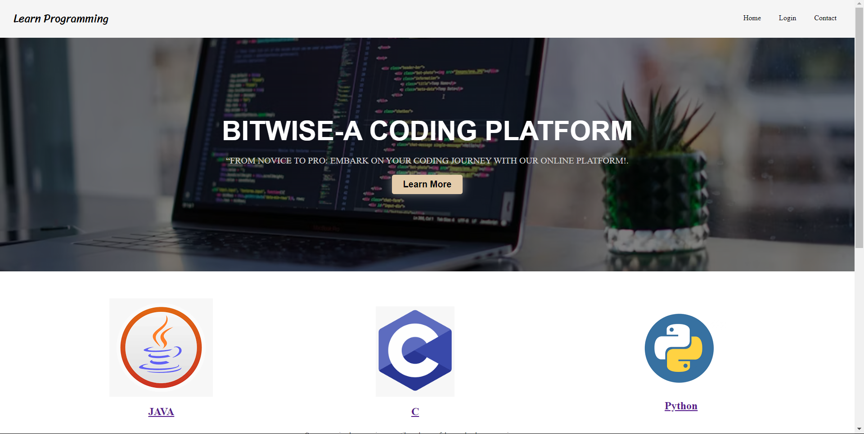
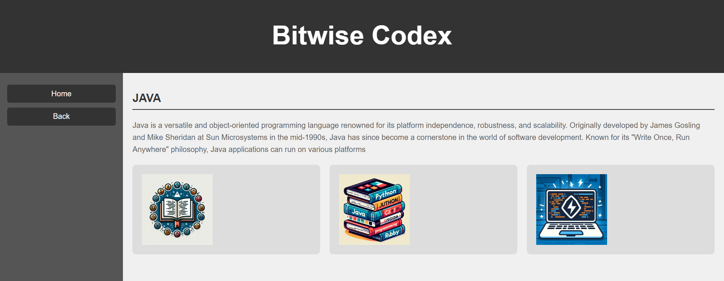
Home page
Programming language Interface

Slide 9
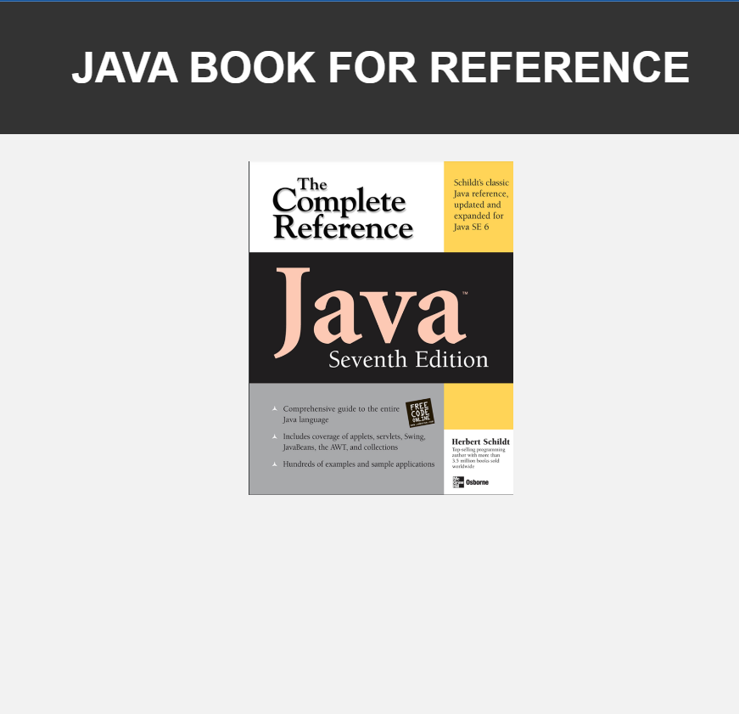
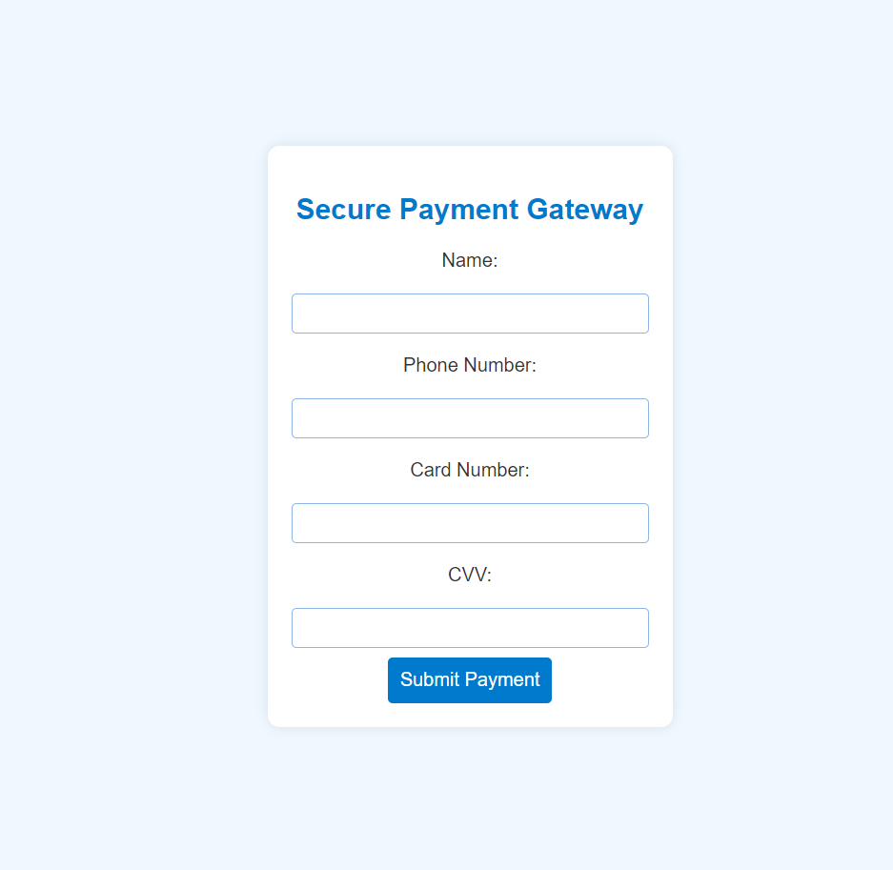
Book for Reference
Payment for Gateway

Slide 10


